Slide 1
SharePoint Framework M12
Jenkins NS
@jenkinsns

Slide 2

Agenda
Module 12: SharePoint Framework Extensions
SharePoint Framework Extensions Overview
Types of Extensions
Creating an application customizer
Creating a field customizer
Adding schema and elements
Creating a command set
SPFx Library
Creating a Library

Slide 3
Introduction
SPFx Extension overview

Slide 4

SPFx Extension
SharePoint Framework v1.3.0 - Sep 25 2017
Extend user experience within modern pages & libraries
Customize notification areas, toolbars, and list data views

Slide 5
SharePoint Framework Extensions Overview
You can use SharePoint Framework (SPFx) Extensions to extend the SharePoint user experience. With SPFx Extensions, you can customize more facets of the SharePoint experience, including notification areas, toolbars, and list data views. SPFx Extensions are available in all Microsoft 365 subscriptions for production usage.
SPFx Extensions enable you to extend the SharePoint user experience within modern pages and document libraries, while using the familiar SPFx tools and libraries for client-side development. Specifically, the SPFx includes three extension types:
Application Customizers
Field Customizers:
Command Sets:

Slide 6
SPFx has three extension types
Application Customizers
Allows HTML placeholders with custom rendering.
It is helpful in embedding js code snippets.
Deployment scope varies from Site collection to Site to list level.
Field Customizers
It is helpful in modifying data views in a list.
It can be used along with site column or a list column to override its presentation in the list.
Command Sets
It helps to extend the SharePoint Command surfaces to add actions, which can work with client-side codes.
Toolbars and context menus can be created using this.
Helps to add action buttons to the list.

Slide 7
Application Customizer
Demo

Slide 8
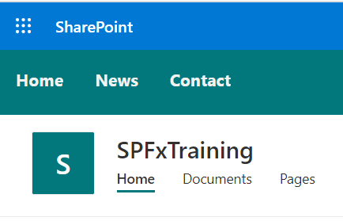
SPFx Application Customizer
Allows HTML placeholders with custom rendering.
It is helpful in embedding js code snippets.
It is helpful in embedding css code snippets.
Deployment scope varies from Site collection to Site to list level.

Slide 9
Field Customizer
Demo

Slide 10
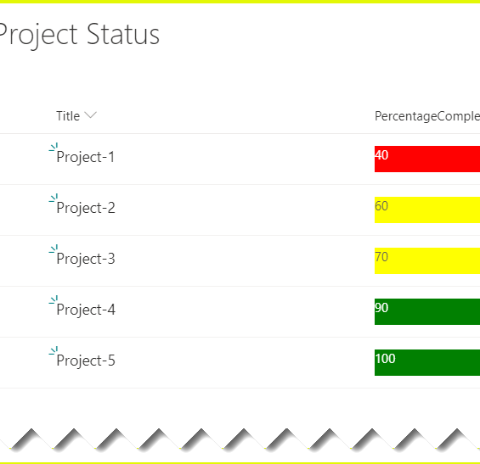
SPFx Field Customizer
By using SPFx field customizers we can modify the list views.
onInit(): The onInit() method get called after this.context and this.properties are assigned, but before the page DOM is ready.
onRenderCell(): onRenderCell() event triggered when each cell is rendered.
onDisposeCell(): onDisposeCell() is used to free up resources that were allocated while rendering.

Slide 11
Listview Command Set Customizer
Demo

Slide 12
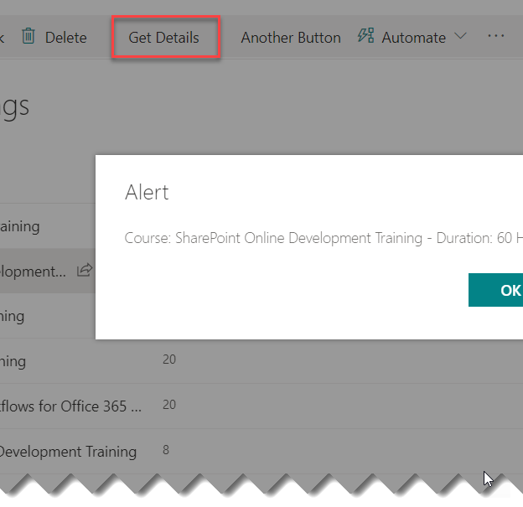
Listview Customizer Command Set
By using command sets, we can add new actions with client-side code to implement the behaviors.
onRenderCell():
onRenderCell() event triggered when each cell is rendered. Here we can use the event.domElement HTML element to extend our functionality.

Slide 13
Library Component

Slide 14
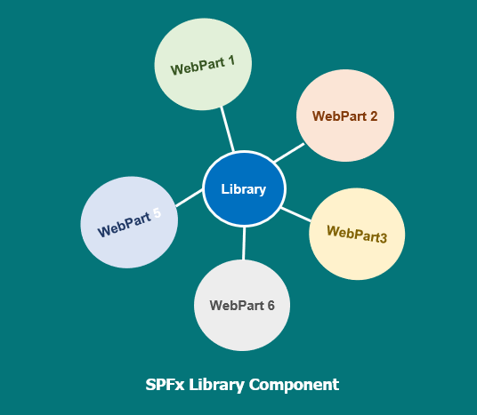
Library Component
The library component type in the SharePoint Framework (SPFx) enables you to have independently versioned and deployed code served automatically for the SharePoint Framework components with a deployment through an app catalog. Library components provide you an alternative option to create shared code, which can be then used and referenced cross all the components in the tenant.

Slide 15
Demo
Build your first SPFx Extension
Create an Application customizer extension
Create a Field customizer extension
Create a command set extension
Create a Library component for SPFx webpart

